Slide 1
Cache
Textbook – Chapter 5

Slide 2
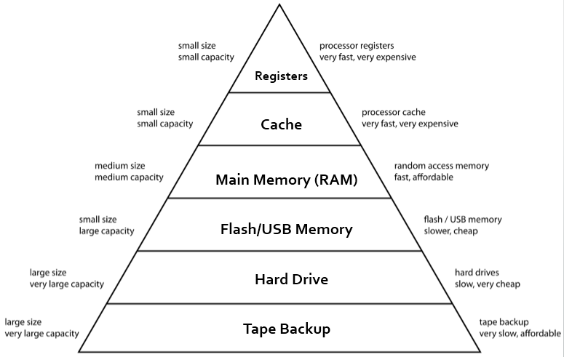
Memory Hierarchy

Slide 3
Principle of Locality
Locality of Reference, also known as the principle of locality, is the tendency of a processor to access the same set of memory locations repetitively over a short period of time.
There are two basic types of reference locality – temporal and spatial locality.
Temporal Locality refers to the reuse of specific data, and/or resources, within a relatively small time duration.
Spatial locality refers to the use of data elements within relatively close storage locations.

Slide 4
Principle of Locality (Contd.)
Temporal Locality: The principle stating that if a data location is referenced then it will tend to be referenced again soon.
Spatial Locality: The locality principle stating that if a data location is referenced, data locations with nearby addresses will tend to be referenced soon.

Slide 5
Principle of Locality (Contd.)
Most programs contain loops, so instructions and data are likely to be accessed repeatedly, showing high amounts of temporal locality.
Since instructions are normally accessed sequentially, programs also show high spatial locality.
Accesses to data also exhibit a natural spatial locality. For example, sequential accesses to elements of an array or a record will naturally have high degrees of spatial locality

Slide 6
Key Characteristics of Computer Memory Systems
Location
Internal
External
Capacity
No of Words/Bytes
Unit of Transfer
Word
Block
Performance
Access Time
Transfer Rate

Slide 7
Accessing a Cache
2^5 = 32 Words Main Memory
Index | V | Tag | Data
000 | N
001 | N
010 | N
011 | N
100 | N
101 | N
110 | N
111 | N
Address | Content
00000
…
11111
The initial state of Cache after power on
Processor Requests – address of 1 word
Block Size – 1 word
Total 8 blocks in cache

Slide 8
Accessing a Cache
Decimal address of reference | Binary address of reference | Assigned cache block (where found or placed) | Hit or miss in cache
22 | 10110 | (10110 mod 8) = 110 | ?

Slide 9
Accessing a Cache
Main Memory
Address | Content
00000 | A
…
3 = 00011 | B
…
16 = 10000 | C
…
18 = 10010 | D
…
22 = 10110 | E
…
26 = 11010 | F
…
Index | V | Tag | Data
000 | N
001 | N
010 | N
011 | N
100 | N
101 | N
110 | N
111 | N
Cache Miss

Slide 10
Accessing a Cache
Main Memory
Address | Content
00000 | A
…
3 = 00011 | B
…
16 = 10000 | C
…
18 = 10010 | D
…
22 = 10110 | E
…
26 = 11010 | F
…
Index | V | Tag | Data
000 | N
001 | N
010 | N
011 | N
100 | N
101 | N
110 | Y | 10 | [10110] = E
111 | N
Cache Miss Handled

Slide 11
Accessing a Cache
Decimal address of reference | Binary address of reference | Assigned cache block (where found or placed) | Hit or miss in cache
22 | 10110 | (10110 mod 8) = 110 | miss
26 | 11010 | (11010 mod 8) = 010 | ?

Slide 12
Accessing a Cache
Main Memory
Address | Content
00000 | A
…
3 = 00011 | B
…
16 = 10000 | C
…
18 = 10010 | D
…
22 = 10110 | E
…
26 = 11010 | F
…
Index | V | Tag | Data
000 | N
001 | N
010 | N
011 | N
100 | N
101 | N
110 | Y | 10 | [10110] = E
111 | N
Cache Miss

Slide 13
Accessing a Cache
Main Memory
Address | Content
00000 | A
…
3 = 00011 | B
…
16 = 10000 | C
…
18 = 10010 | D
…
22 = 10110 | E
…
26 = 11010 | F
…
Index | V | Tag | Data
000 | N
001 | N
010 | Y | 11 | [11010] = F
011 | N
100 | N
101 | N
110 | Y | 10 | [10110] = E
111 | N
Cache Miss

Slide 14
Accessing a Cache
Decimal address of reference | Binary address of reference | Assigned cache block (where found or placed) | Hit or miss in cache
22 | 10110 | (10110 mod 8) = 110 | miss
26 | 11010 | (11010 mod 8) = 010 | miss
22 | 10110 | (10110 mod 8) = 110 | ?

Slide 15
Accessing a Cache
Main Memory
Address | Content
00000 | A
…
3 = 00011 | B
…
16 = 10000 | C
…
18 = 10010 | D
…
22 = 10110 | E
…
26 = 11010 | F
…
Index | V | Tag | Data
000 | N
001 | N
010 | Y | 11 | [11010] = F
011 | N
100 | N
101 | N
110 | Y | 10 | [10110] = E
111 | N
Cache Hit: 10 110 is already in cache

Slide 16
Accessing a Cache
Decimal address of reference | Binary address of reference | Assigned cache block (where found or placed) | Hit or miss in cache
22 | 10110 | (10110 mod 8) = 110 | miss
26 | 11010 | (11010 mod 8) = 010 | miss
22 | 10110 | (10110 mod 8) = 110 | hit
26 | 11010 | (11010 mod 8) = 010

Slide 17
Accessing a Cache
Main Memory
Address | Content
00000 | A
…
3 = 00011 | B
…
16 = 10000 | C
…
18 = 10010 | D
…
22 = 10110 | E
…
26 = 11010 | F
…
Index | V | Tag | Data
000 | N
001 | N
010 | Y | 11 | [11010] = F
011 | N
100 | N
101 | N
110 | Y | 10 | [10110] = E
111 | N
Cache Hit: 11 010 is already in cache

Slide 18
Accessing a Cache
Decimal address of reference | Binary address of reference | Assigned cache block (where found or placed) | Hit or miss in cache
22 | 10110 | (10110 mod 8) = 110 | miss
26 | 11010 | (11010 mod 8) = 010 | miss
22 | 10110 | (10110 mod 8) = 110 | hit
26 | 11010 | (11010 mod 8) = 010 | hit
16 | 10000 | (10000 mod 8) = 000 | miss
3 | 00011 | (00011 mod 8) = 011 | miss
16 | 10000 | (10000 mod 8) = 000 | hit

Slide 19
Accessing a Cache
Main Memory
Address | Content
00000 | A
…
3 = 00011 | B
…
16 = 10000 | C
…
18 = 10010 | D
…
22 = 10110 | E
…
26 = 11010 | F
…
Index | V | Tag | Data
000 | Y | 10 | [10000] = C
001 | N
010 | Y | 11 | [11010] = F
011 | Y | 00 | [00011] = B
100 | N
101 | N
110 | Y | 10 | [10110] = E
111 | N
State of Cache so far

Slide 20
Accessing a Cache
Decimal address of reference | Binary address of reference | Assigned cache block (where found or placed) | Hit or miss in cache
22 | 10110 | (10110 mod 8) = 110 | miss
26 | 11010 | (11010 mod 8) = 010 | miss
22 | 10110 | (10110 mod 8) = 110 | hit
26 | 11010 | (11010 mod 8) = 010 | hit
16 | 10000 | (10000 mod 8) = 000 | miss
3 | 00011 | (00011 mod 8) = 011 | miss
16 | 10000 | (10000 mod 8) = 000 | hit
18 | 10010 | (10010 mod 8) = 010 | ?

Slide 21
Accessing a Cache
Main Memory
Address | Content
00000 | A
…
3 = 00011 | B
…
16 = 10000 | C
…
18 = 10010 | D
…
22 = 10110 | E
…
26 = 11010 | F
…
Index | V | Tag | Data
000 | Y | 10 | [10000] = C
001 | N
010 | Y | 11 | [11010] = F
011 | Y | 00 | [00011] = B
100 | N
101 | N
110 | Y | 10 | [10110] = E
111 | N
10 010 Is this a Hit or Miss?
Notes:
00, 01, 10, 11 …………..010
010

Slide 22
Accessing a Cache
Main Memory
Address | Content
00000 | A
…
3 = 00011 | B
…
16 = 10000 | C
…
18 = 10010 | D
…
22 = 10110 | E
…
26 = 11010 | F
…
Index | V | Tag | Data
000 | Y | 10 | [10000] = C
001 | N
010 | Y | 11 | [11010] = F
011 | Y | 00 | [00011] = B
100 | N
101 | N
110 | Y | 10 | [10110] = E
111 | N
10 010 Is this a Hit or Miss? Cache Miss. How can we handle it?

Slide 23
Accessing a Cache
Main Memory
Address | Content
00000 | A
…
3 = 00011 | B
…
16 = 10000 | C
…
18 = 10010 | D
…
22 = 10110 | E
…
26 = 11010 | F
…
Index | V | Tag | Data
000 | Y | 10 | [10000] = C
001 | N
010 | Y | 10 | [10010] = D
011 | Y | 00 | [00011] = B
100 | N
101 | N
110 | Y | 10 | [10110] = E
111 | N
Cache takes advantage of temporal locality: recently referenced words replace less recently referenced words

Slide 24
Reducing Cache Misses
Fully Associative Cache: A cache structure in which a block can be placed in any location in the cache.
Set-Associative Cache: A cache that has a fixed number of locations (at least two) where each block can be placed.
Important Issues
Locating a block
Choosing which block to replace: least recently used
Direct Mapped Cache: A block can go in exactly one place in the cache

Slide 25
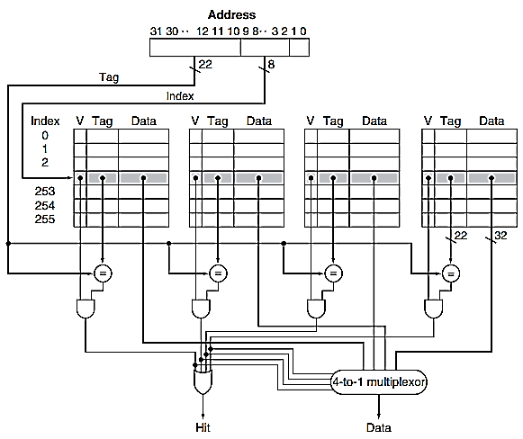
Four-Way Set-Associative Cache
Related Concepts:
Locating a block
Choosing which block to replace: least recently used

Slide 26
Concepts and Terminologies
A memory hierarchy can consist of multiple levels, but data is copied between only two adjacent levels at a time.
Direct-Mapped cache: A cache structure in which each memory location is mapped to exactly one location in the cache.
Tag: A field in a table used for a memory hierarchy that contains the address information required to identify whether the associated block in the hierarchy corresponds to a requested word.
Valid Bit: A field in the tables of a memory hierarchy that indicates that the associated block in the hierarchy contains valid data.

Slide 27
Concepts and Terminologies (Contd.)
Hit: If the data requested by the processor appears in some block in the upper level, this is called a hit.
Miss: If the data is not found in the upper level, the request is called a miss. The lower level in the hierarchy is then accessed to retrieve the block containing the requested data.
Hit rate: The fraction of memory accesses found in a level of the memory hierarchy.
Miss rate: The fraction of memory accesses not found in a level of the memory hierarchy.

Slide 28
Concepts and Terminologies (Contd.)
Hit Time: The time required to access a level of the memory hierarchy, including the time needed to determine whether the access is a hit or a miss.
Miss Penalty: The time required to fetch a block into a level of the memory hierarchy from the lower level, including the time to access the block, transmit it from one level to the other, insert it in the level that experienced the miss, and then pass the block to the requestor.

Slide 29
Summary so far
Programs exhibit both temporal locality, the tendency to reuse recently accessed data items, and spatial locality, the tendency to reference data items that are close to other recently accessed items.
Memory hierarchies take advantage of temporal locality by keeping more recently accessed data items closer to the processor.
Memory hierarchies take advantage of spatial locality by moving blocks consisting of multiple contiguous words in memory to upper levels of the hierarchy.
Accesses that hit in the highest level of the hierarchy can be processed quickly
Accesses that miss go to lower levels of the hierarchy, which are larger but slower

Slide 30
Cache Design
Main Memory
Index | V | Tag | Data
000 | Y | 10 | C
001 | N
010 | Y | 10 | D
011 | Y | 00 | B
100 | N
101 | N
110 | Y | 10 | E
111 | N
Address | Content
00000 | A
…
3 = 00011 | B
…
16 = 10000 | C
…
18 = 10010 | D
…
22 = 10110 | E
…
26 = 11010 | F
…
No. of Cache Blocks = 8
Size of each Block = 1 word
Direct-Mapped cache
What is physical memory address of D ? 10 010

Slide 31
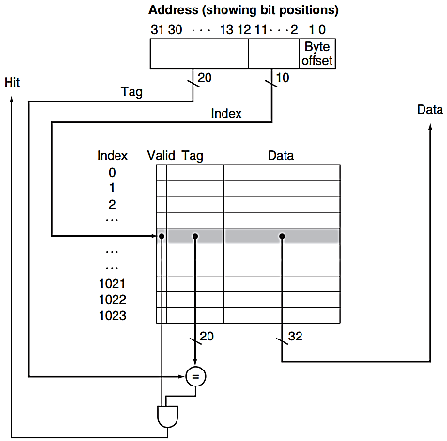
Cache Design
32-bit or 1 word Address
What will be the size of Main Memory in Bytes?
- How can we check if it is a Hit or Miss?
Total Blocks in Cache = 2^10 = = 1024 Blocks
- How many address bits we need to locate the cache index? 10 bits
What will be the size of Tag field?
What will be the size of a block?
Why we are not using 2 LSBs?
What exact size the Cache will take?
Why is this called 4KB Cache?

Slide 32
Cache Design
What exact size the Cache will take?
Size of 1 Entry
= Valid Bit Size + Tag Size+ Data Size
= 1 bit + 20 bits + 32 bits
= 53 bits
Total Space required = 1024 x 53 bits
= 53 K bits
Why is this called 4KB Cache?

Slide 33
Mapping an Address to 1-word Cache Block
Main Memory
Index | V | Tag | Data
000 | Y | 10 | C
001 | N
010 | Y | 10 | D
011 | Y | 00 | B
100 | N
101 | N
110 | Y | 10 | E
111 | N
Address | Content
00000 | A
…
3 = 00011 | B
…
16 = 10000 | C
…
18 = 10010 | D
…
22 = 10110 | E
…
26 = 11010 | F
…
8 Blocks Cache
Size of each block is 1 word
32-words main memory
This is 32 Bytes Cache (8x4 = 32)

Slide 34
Cache Design
32-bit addresses
A direct-mapped cache
The cache size is 2^n blocks, so n bits are used for the index
The block size is 2^m words (2^(m+2) bytes), so m bits are used for the word within the block, and two bits are used for the byte part of the address
The size of the tag field is 32 - (n + m + 2)
The total number of bits in a direct-mapped cache is
2^n x (block size + tag size + valid field size)

Slide 35
Mapping an Address to 1-word Cache Block
Main Memory
Index | V | Tag | Data
000 | Y | 10 | C
001 | N
010 | Y | 10 | D
011 | Y | 00 | B
100 | N
101 | N
110 | Y | 10 | E
111 | N
Address | Content
00000 | A
…
3 = 00011 | B
…
16 = 10000 | C
…
18 = 10010 | D
…
22 = 10110 | E
…
26 = 11010 | F
…
This is 32 Bytes Cache (8x4 = 32)
How many total bits are required for this Cache?

Slide 36
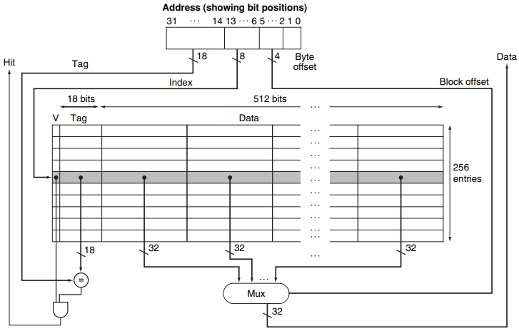
Cache with 256 blocks and 16 words per block
Word offset
How many bits are required in this cache and why?
Notes:
FIGURE 5.9 The 16 KB caches in the Intrinsity FastMATH each contain 256 blocks with 16 words per block. The tag field is 18 bits wide and the index field is 8 bits wide, while a 4-bit field (bits 5–2) is used to index the block and select the word from the block using a 16‑to‑1 multiplexor. In practice, to eliminate the multiplexor, caches use a separate large RAM for the data and a smaller RAM for the tags, with the block offset supplying the extra address bits for the large data RAM. In this case, the large RAM is 32 bits wide and must have 16 times as many words as blocks in the cache.

Slide 37
Homework Cache Design
32KB cache with Block size of 32 words is to be used with 4GB RAM.
Make high level design of following cache.
How many total bits are required for this cache?

Slide 38
Handling Writes 1- Write-Through
Inconsistent Cache and Memory
Write-Through: A scheme in which writes always update both the cache and the next lower level of the memory hierarchy, ensuring that data is always consistent between the two.
With a write-through scheme, every write causes the data to be written to main memory.
These writes will take a long time, likely at least 100 processor clock cycles, and could slow down the processor considerably.

Slide 39
Handling Writes 1- Write-Through using Write Buffer
Write Buffer: A queue that holds data while the data is waiting to be written to memory.
After writing the data into the cache and into the write buffer, the processor can continue execution.
When a write to main memory completes, the entry in the write buffer is freed.
If the write buffer is full when the processor reaches a write, the processor must stall until there is an empty position in the write buffer.
Problem: What if writes are being generated faster than the memory system can accept them?

Slide 40
Handling Writes 2- Write-Back
Write-Back: A scheme that handles writes by updating values only to the block in the cache, then writing the modified block to the lower level of the hierarchy when the block is replaced.
the new value is written only to the block in the cache.
The modified block is written to the lower level of the hierarchy when it is replaced.

Slide 41
Handling Cache Misses (Miss penalty)
Send the original PC value (current PC – 4) to the memory.
Instruct main memory to perform a read and wait for the memory to complete its access (significant processor cycles).
Write the cache entry, putting the data from memory in the data portion of the entry, writing the upper bits of the address (from the ALU) into the tag field, and turning the valid bit on.
Restart the instruction execution at the first step, which will re-fetch the instruction, this time finding it in the cache.

Slide 42
Cache Performance
CPU time = (CPU execution clock cycles + Memory-stall clock cycles) x Clock cycle time

Slide 43
Miss Rate vs Block Size
Increasing the block size usually decreases the miss rate.
The miss rate may go up eventually if the block size becomes a significant fraction of the cache size, because the number of blocks that can be held in the cache will become small, and there will be a great deal of competition for those blocks.
The miss penalty is determined by the time required to fetch the block from the next lower level of the hierarchy and load it into the cache.
The time to fetch the block has two parts: the latency to the first word and the transfer time for the rest of the block.
The transfer time will likely increase as the block size increases.
The improvement in the miss rate starts to decrease as the blocks become larger.

Slide 44
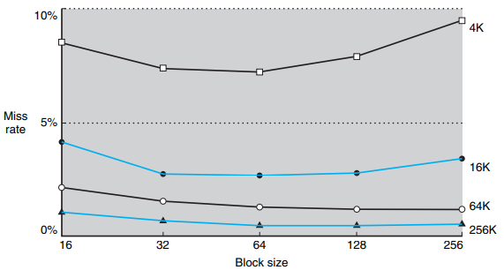
Miss Rate vs Block Size (Contd.)

Slide 45
Four-Way Set-Associative Cache
Related Concepts:
Locating a block
Choosing which block to replace: least recently used

Slide 46
Reducing the Miss Penalty Using Multilevel Caches
Multilevel Cache: A memory hierarchy with multiple levels of caches, rather than just a cache and main memory.
Cache Miss on Level 1 → Find the data in Level 2 Cache

Slide 47
Reference
David A. Patterson, John L. Hennessy, Computer Organization and Design: The hardware/software interface – Chapter 5

